Slide 1
Arithmetic expressions, type conversions, relational and Boolean expressions, Assignment statements, mixed mode assignments

Slide 2
Arithmetic expressions
In programming languages, arithmetic expressions consist of operators, operands, parentheses, and function calls. An operator
can be unary, meaning it has a single operand, binary, meaning it has two operands, or ternary, meaning it has three operands.

Slide 3
Operator Evaluation Order
The operator precedence rules for expression evaluation partially define the order in which the operators of different precedence levels are evaluated.
C-Based Languages
Highest postfix ++, --
prefix ++, --, unary +, -
*, /, %
Lowest binary +, -

Slide 4
Associativity
When an expression contains two adjacent occurrences of operators with the same level of precedence, the question of which operator is evaluated first is answered by the associativity rules of the language. An operator can have either left or right associativity, meaning that when there are two adjacent operators with the same precedence, the left operator is evaluated first or the right operator is evaluated first, respectively.
Associativity in common languages is left to right.
a - b + c
The above expression, left operator is evaluated first.

Slide 5
Parentheses
Programmers can alter the precedence and associativity rules by placing parentheses in expressions.
For example, although multiplication has precedence over addition, in the expression
(A + B) * C
the addition will be evaluated first.

Slide 6
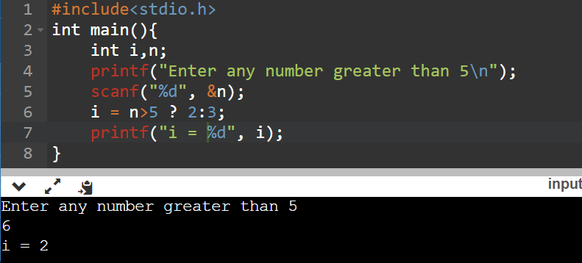
Conditional Expressions
expression_1 ? expression_2 : expression_3
where expression_1 is interpreted as a Boolean expression. If expression_1 evaluates to true, the value of the whole expression is the value of expression_2; otherwise, it is the value of expression_3.
For example,

Slide 7
Type Conversion
Type conversions are either narrowing or widening. A narrowing conversion converts a value to a type that cannot store even approximations of all of the values of the original type. For example, converting a double to a float in Java is a narrowing conversion, because the range of double is much larger than that of float. A widening conversion converts a value to a type that can include at least approximations of all of the values of the original type. For example, converting an int to a float in Java is a widening conversion.
Widening conversions are nearly always safe, meaning that the magnitude of the converted value is maintained. Narrowing conversions are not always safe — sometimes the magnitude of the converted value is changed in the process.

Slide 8
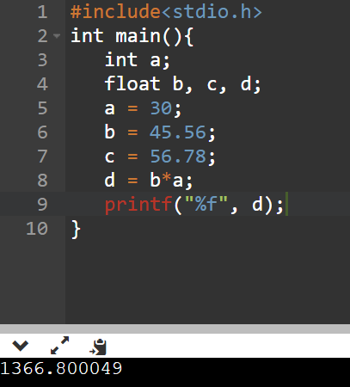
Type conversions can be either explicit or implicit.
Coercion in Expressions, coercion was defined as an implicit type conversion that is initiated by the compiler. Type conversions explicitly requested by the programmer are referred to as explicit conversions, or casts, not coercions.
mixed-mode expressions , operator with operands of different types. Languages that allow such mixed-mode expressions, must define conventions for implicit operand type conversions.
As a simple illustration of the problem, consider the following Java code:
int a;
float b, c, d;
. . .
d = b * a;

Slide 9
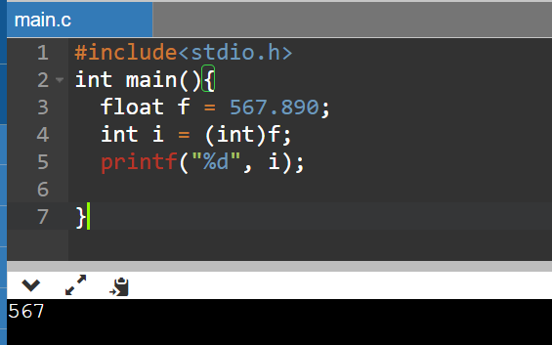
Explicit Type Conversion, Explicit Type Conversion Most languages provide some capability for doing explicit conversions, both widening and narrowing. In some cases, warning messages are produced whenan explicit narrowing conversion results in a significant change to the value of the object being converted.
In the C-based languages, explicit type conversions are called casts. To specify a cast, the desired type is placed in parentheses just before the expression to be converted.

Slide 10
Relational and Boolean Expressions
A relational expression has two operands and one relational operator. The value of a relational expression is Boolean.
The relational operators always have lower precedence than the arithmetic operators, so that in expressions such as
a + 1 > 2 * b
the arithmetic expressions are evaluated first.

Slide 11
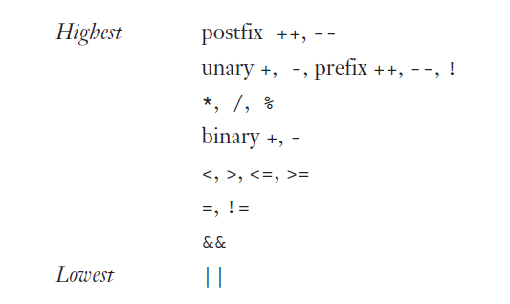
Boolean Expressions, Boolean expressions consist of Boolean variables, Boolean constants, relational expressions, and Boolean operators. The operators usually include those for the AND, OR, and NOT operations.
The precedence of the arithmetic, relational, and Boolean operators in the C-based languages is as follows:

Slide 12
Assignment Statements
Simple Assignments Nearly all programming languages currently being used use the equal sign for the assignment operator.
Compound Assignment Operators, A compound assignment operator is a shorthand method of specifying a commonly needed form of assignment.
For example,
sum += value;
is equivalent to
sum = sum + value;

Slide 13
Unary Assignment Operators, The C-based languages, Perl, and JavaScript include two special unary arithmetic operators that are actually abbreviated assignments. They combine increment and decrement operations with assignment. The operators ++ for increment, and – – for decrement, can be used either in expressions or to form stand-alone single-operator assignment statements.
In the assignment statement, prefix operator
sum = ++ count;
the value of count is incremented by 1 and then assigned to sum.
If the same operator is used as a postfix operator, as in
sum = count ++;
the assignment of the value of count to sum occurs first; then count is incremented

Slide 14
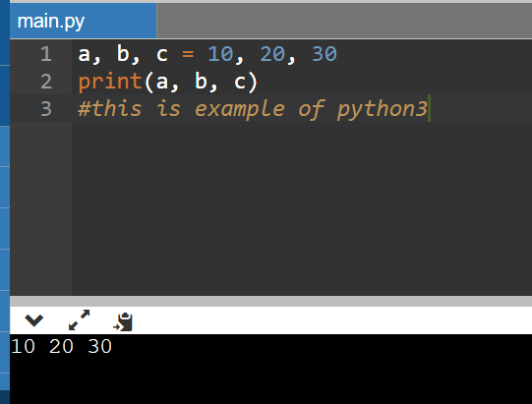
Multiple Assignments, Several recent programming languages, including Perl, Ruby, and Lua, provide multiple-target, multiple-source assignment statements. For example, in Perl one can write
($first, $second, $third) = (20, 40, 60);
The semantics is that 20 is assigned to $first, 40 is assigned to $second, and 60 is assigned to $third.

Slide 15
